Slide 1
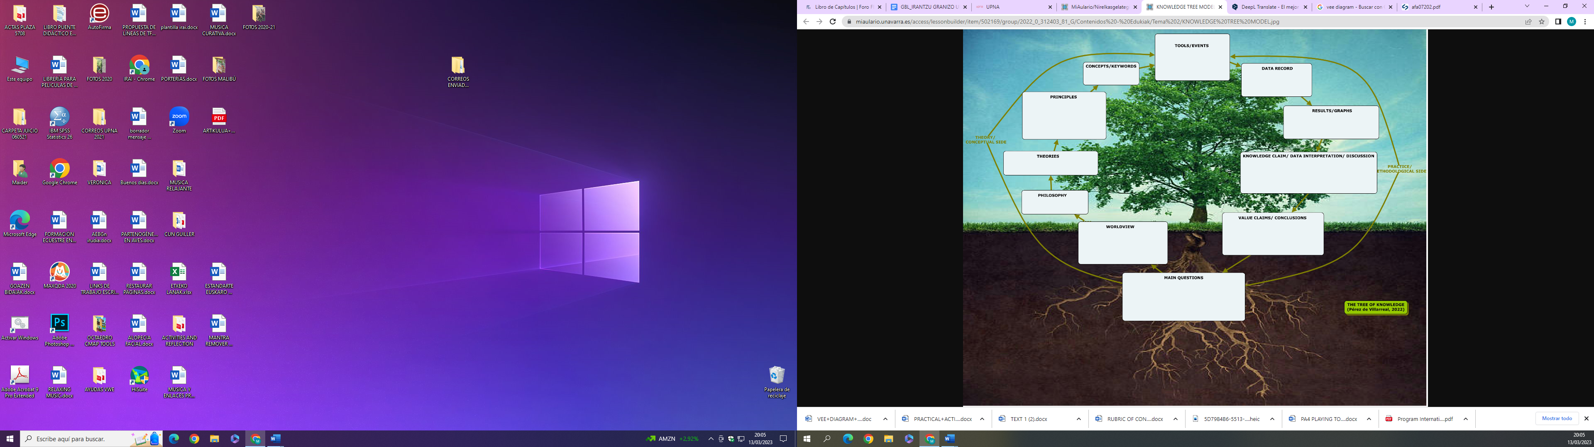
Elements studied or used tools to answer main questions
Regularities perceived
Observations made and recorded of the objects or events
Relationship between concepts that explain how objects of facts behave.
Transformation of data: Tables, graphs, CCMM, statistics
General principles that guide the research
Statements answering the main questions which are reasonable interpretaions of obtained data
Beliefs on the nature of knowledge
Statements based on knowledge claims that declare the valued of the inquiry
General belief and knowledge system wiht motivate and guide the research
Focus questions regarding the research or Project which focus attention on events and objects.

Slide 2
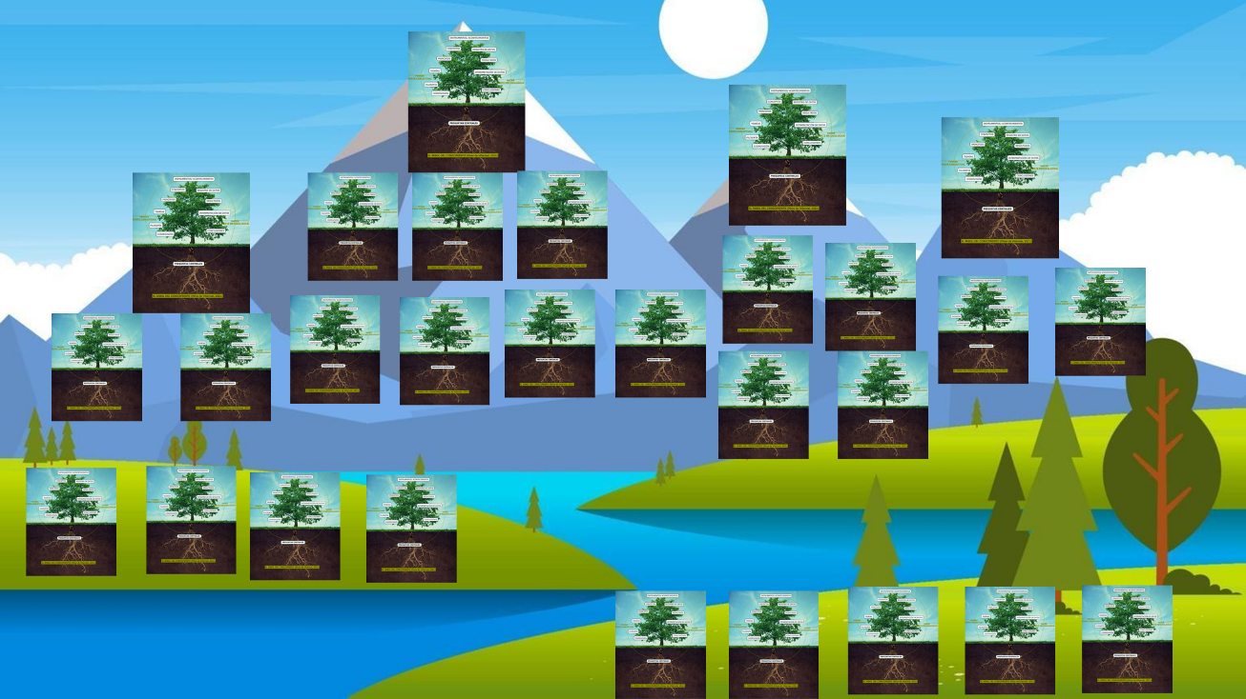
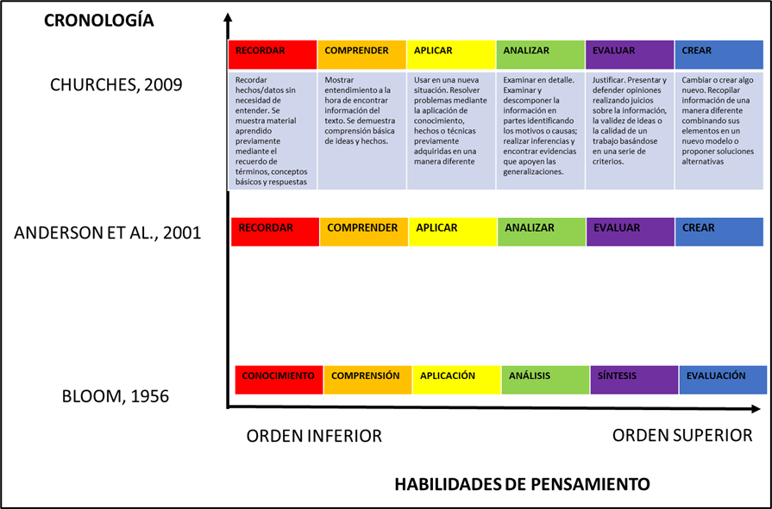
The forest of knowledge (Pérez de Villarreal, 2022)
Diagram depicting the evolution of Bloom's taxonomy

